Slide 1
User Interface Design

Slide 2

Interface Design
Easy to learn?
Easy to use?
Easy to understand?

Slide 3

Interface Design
Typical Design Errors
lack of consistency
too much memorization
no guidance / help
no context sensitivity
poor response
Arcane/unfriendly

Slide 4
Golden Rules
Place the user in control
Reduce the user’s memory load
Make the interface consistent

Slide 5
Place the User in Control
Define interaction modes in a way that does not force a user into unnecessary or undesired actions.
Provide for flexible interaction.
Allow user interaction to be interruptible and undoable.
Streamline interaction as skill levels advance and allow the interaction to be customized.
Hide technical internals from the casual user.
Design for direct interaction with objects that appear on the screen.

Slide 6
Reduce the User’s Memory Load
Reduce demand on short-term memory.
Establish meaningful defaults.
Define shortcuts that are intuitive.
The visual layout of the interface should be based on a real world metaphor.
Disclose information in a progressive fashion.

Slide 7
Make the Interface Consistent
Allow the user to put the current task into a meaningful context.
Maintain consistency across a family of applications.
If past interactive models have created user expectations, do not make changes unless there is a compelling reason to do so.

Slide 8
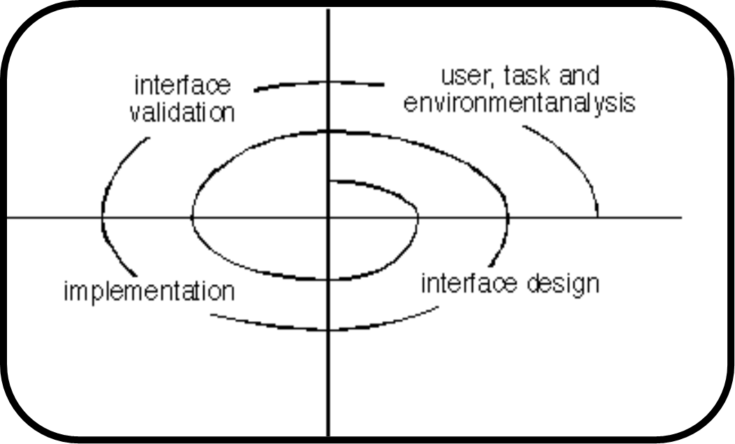
User Interface Design Process

Slide 9
Task Analysis and Modeling
All human tasks required to do the job (of the interface) are defined and classified
Objects (to be manipulated) and actions (functions applied to objects) are identified for each task
Tasks are refined iteratively until the job is completely defined

Slide 10
Interface Design Activities
1. Establish the goals and intentions for each task.
2. Map each goal/intention to a sequence of specific actions.
3. Specify the action sequence of tasks and subtasks, also called a user scenario, as it will be executed at the interface level.
4. Indicate the state of the system, i.e., what does the interface look like at the time that a user scenario is performed?
5. Define control mechanisms, i.e., the objects and actions available to the user to alter the system state.
6. Show how control mechanisms affect the state of the system.
7. Indicate how the user interprets the state of the system from information provided through the interface.

Slide 11
Common Design Issues
System response time
User help facilities
Error information handling
Command labeling

Slide 12
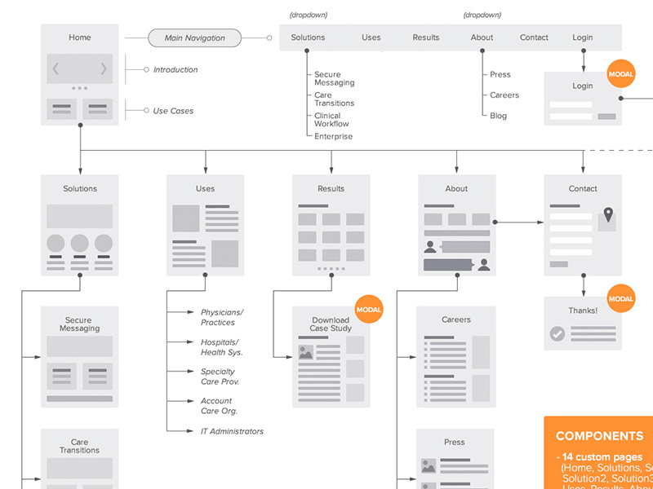
Site Map and story board

Slide 13
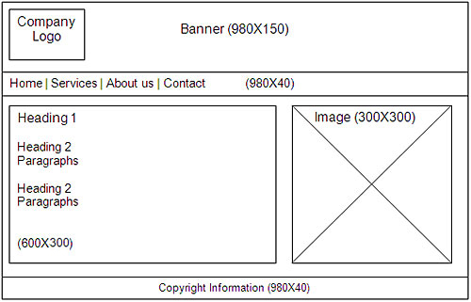
Story board

Slide 14
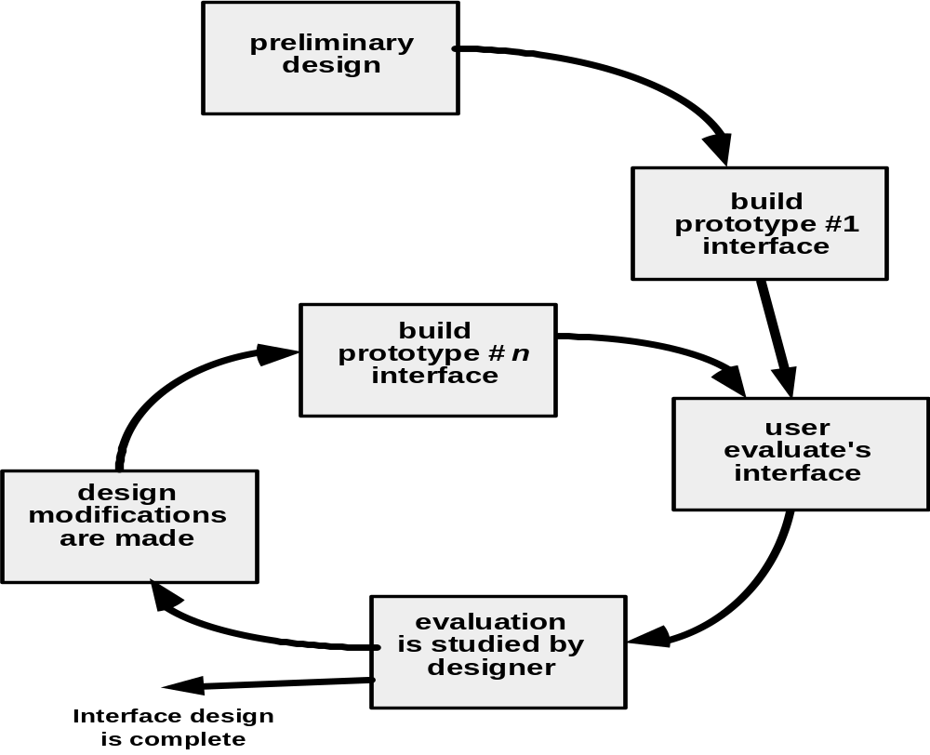
Design Evaluation Cycle

Slide 15
Thank you!

